Slide 1
Chapter 7
Information Systems and Strategy

Slide 2
The Role of Information Systems in Business Today
How information systems are transforming business
Emerging mobile digital platform
Growing business use of “big data”
Growth in cloud computing
Globalization opportunities
Internet has drastically reduced costs of operating on global scale
Increases in foreign trade, outsourcing
Presents both challenges and opportunities

Slide 3
The Role of Information Systems in Business Today
In the emerging, fully digital firm:
Significant business relationships are digitally enabled and mediated.
Core business processes are accomplished through digital networks.
Key corporate assets are managed digitally.
Digital firms offer greater flexibility in organization and management.
Time shifting, space shifting

Slide 4
The Role of Information Systems in Business Today
Growing interdependence between:
Ability to use information technology and
Ability to implement corporate strategies and achieve corporate goals
Notes:
In the opening case, the UPS Interactive Session later in the chapter, and with many of the Interactive Sessions and opening cases in the book, it will be useful to ask students to explain how various information systems succeeded or failed in achieving the six strategic business objectives. You might ask the students to think about some other business objectives and think about how IT might help firms achieve them. For instance, speed to market is very important to firms introducing new products. How can IT help achieve that objective?

Slide 5
The Role of Information Systems in Business Today
Firms invest heavily in information systems to achieve six strategic business objectives:
Operational excellence
New products, services, and business models
Customer and supplier intimacy
Improved decision making
Competitive advantage
Survival

Slide 6
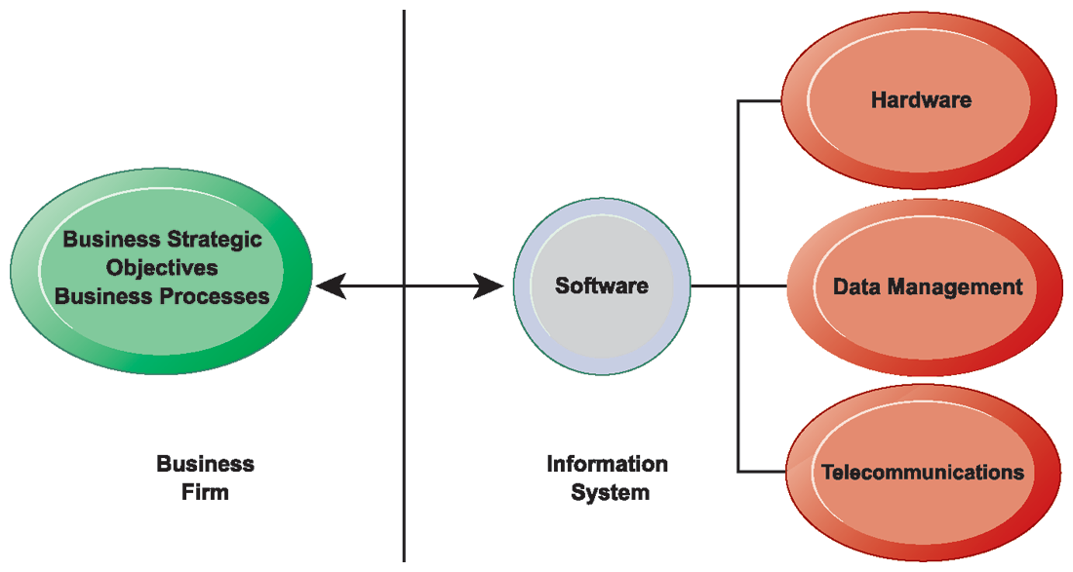
The Interdependence Between Organizations and Information Technology
Figure 1.2
In contemporary systems there is a growing interdependence between a firm’s information systems and its business capabilities. Changes in strategy, rules, and business processes increasingly require changes in hardware, software, databases, and telecommunications. Often, what the organization would like to do depends on what its systems will permit it to do.
Notes:
The basic point of this graphic is that in order to achieve its business objectives, a firm will need a significant investment in IT. Going the other direction (from right to left), having a significant IT platform can lead to changes in business objectives and strategies. Emphasize the two-way nature of this relationship. Businesses rely on information systems to help them achieve their goals; a business without adequate information systems will inevitably fall short. But information systems are also products of the businesses that use them. Businesses shape their information systems and information systems shape businesses.

Slide 7
The Role of Information Systems in Business Today
Operational excellence:
Improvement of efficiency to attain higher profitability
Information systems, technology an important tool in achieving greater efficiency and productivity
Walmart’s Retail Link system links suppliers to stores for superior replenishment system
Notes:
Walmart is the most efficient retailer in the industry and exemplifies operational excellence. You could ask students to name other businesses that they believe exhibit a high level of operational excellence. Do customers perceive operational excellence? Does it make a difference for customer purchasing? What Web sites strike students as really excellent in terms of customer service? If you have a podium computer, you might want to visit the Walmart site and the Amazon site to compare them in terms of ease of use.

Slide 8
The Role of Information Systems in Business Today
New products, services, and business models:
Business model: describes how company produces, delivers, and sells product or service to create wealth
Information systems and technology a major enabling tool for new products, services, business models
Examples: Apple’s iPad, Google’s Android OS, and Netflix
Notes:
You could ask students to name other new products or business models that they’ve encountered and how they might relate to new information systems or new technology. One way to encourage participation is ask students to help you list on the blackboard some really interesting recent digital product innovations. Discussing “green technologies” such as wind, solar, and hybrid vehicles is always fun. In this context, what role will IT be playing in the development of these technologies?

Slide 9
The Role of Information Systems in Business Today
Customer and supplier intimacy:
Serving customers well leads to customers returning, which raises revenues and profits.
Example: High-end hotels that use computers to track customer preferences and used to monitor and customize environment
Intimacy with suppliers allows them to provide vital inputs, which lowers costs.
Example: JCPenney’s information system which links sales records to contract manufacturer
Notes:
You could ask students what types of companies might rely more on customer and supplier intimacy more than others and which companies they feel have served them exceptionally well. Ask the students to identify online sites that achieve a high degree of customer intimacy. Sites to visit would include Netflix, Amazon, and other sites which have recommender systems to suggest purchase ideas to consumers.

Slide 10
The Role of Information Systems in Business Today
Improved decision making
Without accurate information:
Managers must use forecasts, best guesses, luck
Results in:
Overproduction, underproduction
Misallocation of resources
Poor response times
Poor outcomes raise costs, lose customers
Example: Verizon’s Web-based digital dashboard to provide managers with real-time data on customer complaints, network performance, line outages, and so on
Notes:
You could ask students if they have ever been recipients of exceptional service from a company made possible by improved decision making and whether or not information systems contributed to that level of service. For example, perhaps they had a power outage and it took a very short (or very long) time for the utility company to correct the error.

Slide 11
The Role of Information Systems in Business Today
Competitive advantage
Delivering better performance
Charging less for superior products
Responding to customers and suppliers in real time
Examples: Apple, Walmart, UPS
Notes:
Emphasize that achieving any of the previous four business objectives represents the achievement of a competitive advantage as well.

Slide 12
The Role of Information Systems in Business Today
Survival
Information technologies as necessity of business
Industry-level changes
Example: Citibank’s introduction of ATMs
Governmental regulations requiring record-keeping
Examples: Toxic Substances Control Act, Sarbanes-Oxley Act
Dodd-Frank Act
Notes:
Ask students if they can name any examples of companies that failed to survive due to unwillingness or inability to update their information systems. The Sarbanes-Oxley Act (2002) requires that public firms keep all data, including e-mail, on record for 5 years. The Dodd-Frank Act (2010) requires financial services firms to develop extensive new compliance reports. You could ask students if they appreciate why information systems would be useful toward meeting the standards imposed by these new federal statutes.

Slide 13
The Impact of Information Systems on Organizations
Economic impacts
IT changes relative costs of capital and the costs of information.
Information systems technology is a factor of production, like capital and labor.
IT affects the cost and quality of information and changes economics of information.
Information technology helps firms contract in size because it can reduce transaction costs (the cost of participating in markets)
Outsourcing
Notes:
IT figures to replace the function of more middle managers as time passes, as well as reduce the need for other forms of capital (buildings, machinery). Ensure that students understand what is meant by “economics of information” and why outsourcing is a possibility due to IT.

Slide 14
The Impact of Information Systems on Organizations
Organizational and behavioral impacts
IT flattens organizations
Decision making is pushed to lower levels.
Fewer managers are needed (IT enables faster decision making and increases span of control).
Postindustrial organizations
Organizations flatten because in postindustrial societies, authority increasingly relies on knowledge and competence rather than formal positions.
Notes:
Ask students to explain what is meant by authority relying on knowledge and competence rather than formal positions. Why might this “flatten” the organization? The idea here is that with sufficient IT, competent workers will be able to accomplish more on their own than they would under a more hierarchical arrangement.

Slide 15
Using Information Systems to Develop Competitive Strategies
Why do some firms become leaders in their industry?
Michael Porter’s competitive forces model
Provides general view of firm, its competitors, and environment
Five competitive forces shape fate of firm:
Traditional competitors
New market entrants
Substitute products and services
Customers
Suppliers
Notes:
Porter’s competitive forces model is intended to explain why some firms do better than others. Do students believe that this model captures this idea effectively? Which factor is most important to a firm’s success? You can make a list of five well-known firms on the blackboard or screen and ask students, for each firm, which do they think are the most important competitive forces.

Slide 16
Using Information Systems to Develop Competitive Strategies
Traditional competitors
All firms share market space with competitors who are continuously devising new products, services, efficiencies, and switching costs.
New market entrants
Some industries have high barriers to entry, for example, computer chip business.
New companies have new equipment, younger workers, but little brand recognition.
Notes:
Ask students to name different industries and describe the benefits and drawbacks of being a new market entrant in each industry.

Slide 17
Using Information Systems to Develop Competitive Strategies
Substitute products and services
Substitutes customers might use if your prices become too high, for example, iTunes substitutes for CDs
Customers
Can customers easily switch to competitor's products? Can they force businesses to compete on price alone in transparent marketplace?
Suppliers
Market power of suppliers when firm cannot raise prices as fast as suppliers
Notes:
Ask students to name different businesses and describe whether or not customers have great control over the business or vice versa, or whether substitute products are a large or insignificant threat to the success of the business.

Slide 18
Using Information Systems to Develop Competitive Strategies
Four generic strategies for dealing with competitive forces, enabled by using IT:
Low-cost leadership
Product differentiation
Focus on market niche
Strengthen customer and supplier intimacy
Notes:
Here you can make a list of five well-known firms and then analyze with students the major thrust of their strategy. Walmart is a good example to start with because of its emphasis on low-cost leadership.

Slide 19
Using Information Systems to Develop Competitive Strategies
The Internet’s impact on competitive advantage
Transformation or threat to some industries
Examples: travel agency, printed encyclopedia, media
Competitive forces still at work, but rivalry more intense
Universal standards allow new rivals, entrants to market
New opportunities for building brands and loyal customer bases
Notes:
Do students believe it is easier or harder to gain a competitive advantage via the Internet as opposed to more traditional means? Table 3-5 describes the impact of the Internet on various competitive forces.

